Slide 1
BREAKING INTO FILM
NAME: GROUP 5
1. Mika Benson
2. Filda Kiarie
3. Grace Mwende
4. Austin Kanja
5. Chris Kimau
6. Nicholas Miencha
7. Franciscar Mutie DATE: NOVEMBER - 2024

Slide 2

INTRODUCTION OVERVIEW
Starting a New Movie Studio
Our company is embarking on an exciting venture, entering the burgeoning film industry with the launch of a new studio. This initiative comes at a time of unprecedented growth in the demand for original video content, prompting us to explore the intricacies of film production. As part of our strategy, we aim to become a formidable player in the film market by harnessing market insights and trends.

Slide 3

PROBLEM STATEMENT
Navigating the Film Market
In response to the growing trend of corporations producing their own video content, our company is entering the film market. However, the lack of experience in movie production presents a significant challenge. We must analyze how different types of films perform at the box office to ensure our new studio's success. Through careful research, we aim to gather insights that can guide the type of films we should create, ensuring alignment with market demand.

Slide 4
OBJECTIVES
1. GENRE PERFORMANCE EVALUATION
2. IDENTIFY SUCCESSFUL STUDIOS
3. REVENUE AND BUDGET ANALYSIS
Evaluate the performance of various film genres in both domestic and international markets.
Identify the movie studios that consistently produce high-performing films.
Investigate the correlation between production budgets and both domestic and international revenues.

Slide 5

OBJECTIVES…
4. EXPLORING PRODUCTION TRENDS
Film production trends reveal industry shifts. Understanding these trends helps studios balance creative expression with audience demand.
5. UNDERSTANDING POPULARITY SCORES & AVERAGE RATINGS
A film's popularity score gives us a glimpse into its cultural and commercial connection with audiences. The average rating reflects shared thoughts from critics and viewers, acting as a guide to how well a film is valued and its storytelling brilliance.

Slide 6
METHODOLOGY
MODEL EVALUATION AND PERFORMANCE METRICS
EXPLORATORY DATA ANALYSIS
STATISTICAL ANALYSIS
EDA is a crucial initial step in data analysis. It summarizes dataset features, through visuals, helping to understand trends, identify patterns, and detect anomalies in data.
This explores variable relationships, validating assumptions and drawing inferences from samples. Key techniques; hypothesis testing, regression, and variance analysis.
This process ensures that models not only fit the training data but also generalize well to new datasets, which is essential for their success. A structured evaluation process aids in selecting the optimal model for deployment.

Slide 7
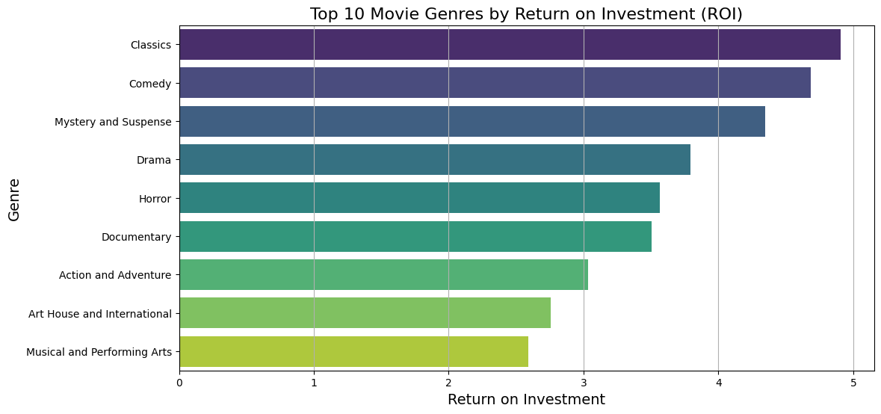
TOP PERFORMING GENRES
Overview of top genres performing at box offices.

Slide 8
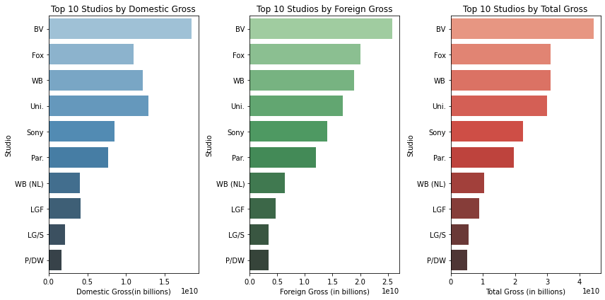
LEADING FILM STUDIOS
Studios Leading the Pack
Several film studios have consistently produced movies that perform exceptionally well at the box office. By studying their approaches, our new studio can adopt best practices that align with successful film development.

Slide 9
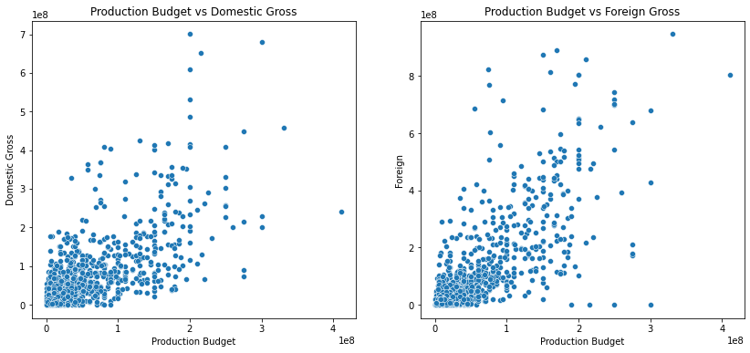
BUDGET VS REVENUE

Slide 10
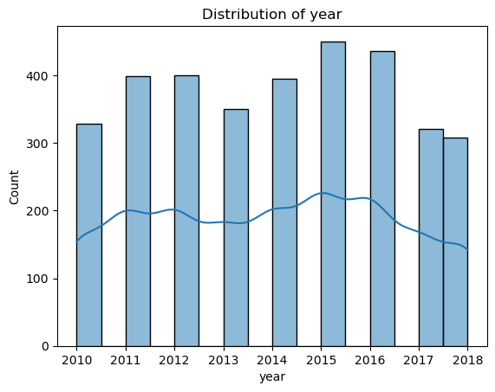
PRODUCTION TRENDS
Evolving Film Techniques
Film production technology has seen major improvements in digital cinematography and visual effects. These advancements help lower production costs while enabling complex storytelling through enhanced visuals.

Slide 11
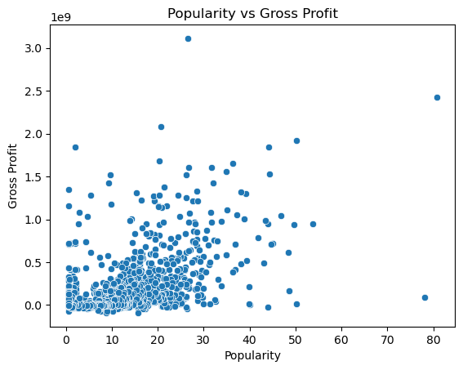
AUDIENCE IMPACT
Popularity vs. Gross (Domestic & Worldwide)
There is moderate positive correlation between popularity and gross income.

Slide 12
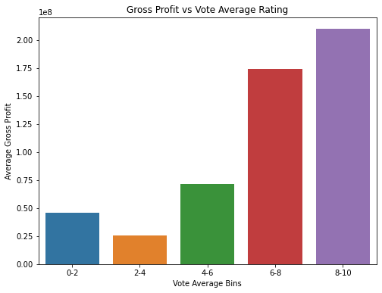
AUDIENCE IMPACT
Rating vs. Gross (Domestic & Worldwide)
The correlation between average rating and both gross earnings is weak, which suggests that ratings do not strongly predict earnings.

Slide 13
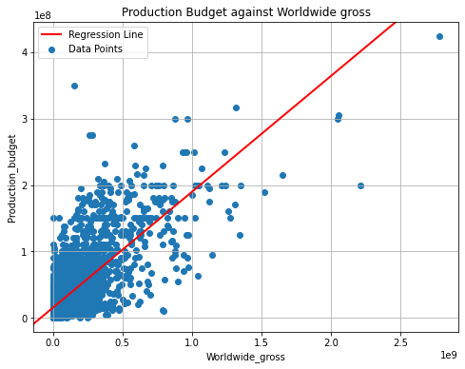
MODEL EVALUATION
Impact of Production Budget on Worldwide Gross
The first model evaluated how varying production budgets influence the worldwide gross of films. By examining historical data, this model helps identify budget ranges that maximize revenue outcomes, providing valuable insights for studios when allocating resources

Slide 14
MODEL EVALUATION
Trend in Movie Production

Slide 15

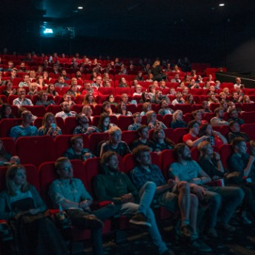

STRATEGIC INSIGHTS
Guidelines for Success
Our studio should focus on producing high-quality films in genres with international appeal, like Classics and Comedy. We must adjust production budgets wisely, and engage audiences via social media and targeted marketing to meet market demands.

Slide 16

CONCLUSION
Summarizing Key Insights
This analysis identified prevalent trends and key contributors to box office success. Strategic insights into genre performance, studio attributes, and budget allocations are crucial for guiding our film production decisions moving forward.

Slide 17
RECOMMENDATIONS
1. FOCUS ON CLASSICS AND COMEDY
2. PARTNER WITH SUCCESSFUL STUDIOS
3. OPTIMIZE BUDGET ALLOCATION
Given strong performance domestically, prioritize producing action and family films. These genres' universal appeal supports consistent box office success.
Collaborating with established studios can leverage their expertise. Such partnerships enhance our knowledge and capabilities in film production.
Incorporate a balanced approach to budget investment. Ensure funds are allocated thoughtfully across pre-production, production, and marketing.

